Slide 1
Unique Aspects of Accounting for State and Local Governments
November 17, 2022
Wenchen Wang

Slide 2
Reason for Different Reporting for Govt.
Reason for Different Reporting for Govt.
Governments are governed by elected officials.
Must ensure that dollars are not expended different than their actions.

Slide 3
Fund Accounting
Used by non-profit organizations and governmental organizations
Divides accounting records into separate sub-entities
Three classes of funds for govt. orgs
Governmental funds
Operating activities of the government → Modified-accrual
Proprietary funds
Activities that are run on a business-like basis → Accrual
Fiduciary funds
Government's activities as trustee and agent → Accrual
Notes:
The cash basis of accounting recognizes inflows and outflows of cash. Under this basis, revenues are recognized and recorded only when cash is received, and expenses are recognized only when payments are made.
Accrual basis of accounting recognize revenues and expenses wen the actual services have been provided and the actual resources have been used and the revenues for the services and resources have already been incurred.

Slide 4
Modified Accrual Accounting
Modified Accrual Accounting
Modified Accrual Accounting
Revenues
Measurable and Available
Earned
Collected
Payment has been
received or will be
received soon
Service has
been provided
Payment has been received
Accrual
Basis
Modified
Accrual Basis
Cash
Basis
Notes:
We now introduce the concept of modified accrual accounting, a method widely used by US state and local governments. Under this basis of accounting the primary focus is on short-term or current financial resources, as opposed to total economic resources. The timing of when accruals are made is the fundamental difference between the accrual and the modified accrual bases of accounting. This difference in timing yields critical differences in when and how revenues, expenditures, fixed assets, and long-term liabilities are recorded.
Under modified accrual accounting, a government recognizes revenues when it has a current financial resource inflow. This may occur before cash is received. For example, if taxes are owed to the government and are measurable and available, they are treated as revenues, even if they have not yet been collected. Clearly this differs from the cash basis. The word “available” means that they must be collectible in or shortly after the end of the accounting period.

Slide 5
Modified Accrual Accounting
Revenues: “Measurable and Available”
If it is expected they will be collected during one-year OR
within a short period of time (within 60 days after the end of the year)
Example:
A city issues tax bills for $10,000
The city collects $7,000 during the year the bills are issued
Receives $1,000, 30 days after the year ends
Collects $2,000 three months after the year ends
Revenue: $7,000 + $1,000 = $8,000
Next year
Deferred inflow resource
Notes:
Sixty days or less is the period widely used as a measure of availability. Any amounts that will be collected within 60 days of the end of the year are typically considered to be available and are treated as revenues by most governments during the year billed, rather than the following year when they are collected.

Slide 6
Modified Accrual Accounting
Modified Accrual Accounting
Expenditures
Encumbrance
Acquisition/
Delivery
Use
Payment
Appropriation
Order has
been received by buyer.
Order has
been placed.
Item is
consumed.
Payment is
made.
Authorization
to spend money.
Modified
Accrual
Basis -
Expenditure
Accrual
Basis
Expense
Cash
Basis
Expense
No expense
at this time -
any basis.
No expense
at this time -
any basis.
Notes:
Under modified accrual, resource outflows are expenditures rather than expenses. That is, expenditures are recognized when resources are acquired, while expenses are recognized when resources are either paid for (cash basis) or consumed (accrual basis).
Under cash accounting, resources are considered to flow out of the organization and an expense is incurred when cash is paid. Under accrual accounting, resources flow out of the organization and an expense is incurred when a resource has been consumed in the process of generating revenue. In modified accrual accounting, however, resources are considered to leave the organization and an expenditure occurs as soon as the organization becomes legally obligated to pay for a resource and the organization knows that payment will be made from available resources.

Slide 7
Modified Accrual Accounting
Expenditures:
Organization is legally obligated to pay for a resource, and
The payment will be made
Example:
May 1: Order fireworks
June 15: Fireworks arrive
July 4: Fireworks are used
August 15: Payment is made
Encumbrance
Acquisition
Use
Payment

Slide 8
Implications of
Modified Accrual Accounting
No long-term assets
Long-term acquisitions (buildings and equipment) are recognized as expenditures when acquired
No long-term liabilities
Proceeds from borrowing are treated as a non-revenue source of fund balance rather than as a liability.
Principal and interest are recognized when they are paid.
Assets | = | Liabilities | + | Fund Balance
Cash |  |  |  | Other Financing Sources
Notes:
Current assets and current liabilities only
When an organization using the modified accrual method borrows money on a long-term basis, a liability is not created in the fund. Rather, the asset cash and fund balance increase in the fundamental equation of accounting.

Slide 9
Acquiring a Building Transaction
Modified Accrual Accounting
Assume that a building is purchased for $270,000, with full payment in cash.
Assets | = | Liabilities | + | Fund Balance
Cash
Capital expenditure
($270,000)
($270,000)

Slide 10
Acquiring a Building Transaction
Modified Accrual Accounting
What if the Town issued a bond for $270,000 to pay for the building?
Capital Project Funds
Assets | = | Liabilities | + | Fund Balance
Cash
Other Financing Source
$270,000
$270,000
Cash
Capital Expenditure
($270,000)
($270,000)

Slide 11
Long-Term Liabilities
Modified Accrual Accounting
When a government borrows money on a long-term basis:
No liability is created on the balance sheet.
A government has a loan for $1,000,000
Assets | = | Liabilities | + | Fund Balance
Cash
Other Financing Source
$1,000,000
$1,000,000
Note that the increase in the fund balance is not referred to as revenue.

Slide 12
Debt Repayment Transaction
Modified Accrual Accounting
A town made a payment of the interest and principal for $10,000 and $45,000, respectively. Payments were made from the debt service fund. How were the payments recorded?
Debt Service Fund
Assets | = | Liabilities | + | Fund Balance
Interest expenditure
Cash
($10,000)
($55,000)
Principal expenditure
($45,000)
Both the interest and the principal are recorded as expenditures.

Slide 13
Governmental Fund Accounting
Divides accounting records into separate sub-entities
Three classes of funds
Governmental funds
Operating activities of the government → Modified-accrual
Proprietary funds
Activities that are run on a business-like basis → Accrual
Fiduciary funds
Government's activities as trustee and agent → Accrual
Notes:
The funds used by governments are generally broken down into three main classifications: governmental funds, proprietary funds, and fiduciary funds.

Slide 14
Governmental Funds
Governmental Funds
General Funds
Day-to-day revenues and expenditures
Routine and ordinary activities of the government
Special Revenue Funds
Specific identifiable purposes
Restrictions: Legal – based on management decisions
Capital Project Funds
Major acquisitions of plant and equipment
To repay principal and interest on long-term debt
Restricted
Debt Service Funds
Permanent Funds
Earnings can be used, not principal.
Environmental – Public education
Notes:
Governmental funds are the typical funds used to operate most governments. These include the general funds, special revenue funds, capital projects funds, debt service funds, and permanent funds. Governmental funds record transactions using the modified accrual basis of accounting.
The general fund is similar to the operating fund or a fund without donor restrictions in a not-for-profit organization. This is the fund that is used for the bulk of the day-to-day revenues and expenditures of the government. Money from the general fund can be used for any of the routine, ordinary activities of government. In effect, any resource or obligation, revenue, or expenditure that is not accounted for in another fund will be accounted for in the general fund.
Special revenue funds are used for specific identifiable purposes other than debt service payments and the acquisition of capital assets. These are akin to funds with donor restrictions for not-for-profit organizations. The restrictions may be legal or may be based on management decisions to better control the use of resources. For example, revenue from state gasoline taxes might be earmarked for highway maintenance. All receipts from the tax would go into a special fund, and payments from that fund could be used only for the restricted or specified purpose.
The capital projects fund is used to account for major acquisitions of plant or equipment. Note that money is accumulated in this fund prior to acquisition of the capital assets. Alternatively, money may be transferred into the capital projects fund from another fund before a purchase is made. Often, a combination of accumulated and transferred monies is used for capital acquisitions. Some smaller acquisitions, such as the purchase of cars, may be paid for from the general fund. Usually, the decision of whether to use the capital projects fund depends on the dollar amount and expected life of the equipment. For example, in a large city the cost of a police car might be low enough, and its life short enough, that it would not be considered a major capital acquisition. In such a case, it makes sense to pay for such cars from operating revenues in the general fund. Note that whether the acquisition is a car paid for from the general fund or a building is paid for from the capital projects fund, under the modified accrual basis of accounting used for governmental funds no long-term asset is recorded. Instead, cash decreases or a short-term payable increases, and an expenditure is recorded for the full cost of the item.
The debt service fund is used to account for the accumulation of resources to repay principal and pay interest on long-term debt. In many cases, governments are required to transfer enough money annually into the debt service fund to cover these required payments. Money in the fund is then restricted to making debt service payments.
Permanent funds are similar to endowment funds in not-for-profit organizations. Earnings, but not principal, may be spent from these funds. Environmental permanent funds and public education permanent funds are perhaps the most common examples of permanent funds in governments. Their function is to preserve some level of funding for specific purposes in perpetuity.

Slide 15
Proprietary Funds
Business-like basis: Hospitals, museums, bridges, airports
User charges: Fees, tolls
Governmental units that provide goods and services to individual organizations
Sewer, water, mass transit
Enterprise Funds
Internal Service Funds
Account for elements of the government that provide services to other governmental units
Notes:
Proprietary funds are used to account for activities that are run on a business-like basis. For example, these activities might include operating hospitals, museums, bridges, or an airport owned by a government. In general, governments do not match specific sources of revenues with specific expenses. For instance, governments provide police protection but do not have an earmarked tax for that purpose. Governmental funds are typically used to account for such services. In other cases, such as government-owned hospitals or marinas, there may be a desire to finance a program or activity primarily or wholly through user charges. In such cases, proprietary funds are used. Proprietary funds record transactions using the accrual basis of accounting.
Proprietary funds typically get their revenues from a variety of user fees, tolls, and other charges rather than from taxes. The two types of proprietary funds are internal service funds and enterprise funds.
Many governments own golf courses, other recreational facilities, and other activities that provide services to the public on a business-like basis. In some cases, there is a desire for these activities to earn a profit or at least to be self-sufficient. When the government is essentially running a business, charging the public for services it consumes, it establishes an enterprise fund, such as a golf course fund. If the enterprise loses money, that might affect whether the government would want to continue offering the service or would be better off moving to privatize the service. Conversely, some enterprise funds, such as mass transit, are typically tax-subsidized.
Internal service funds are established for elements of government that provide specific services to other government units. For example, a government might have a car pool department. The car pool provides cars to all branches of government as needed. The idea of the car pool is that the city government will need to own fewer cars in total if each branch does not buy its own cars. This is because the cars will be more fully used: when one agency does not need a specific car, another agency can use it.

Slide 16
Fiduciary Funds
Held funds for others → Specific manner of purpose
Agency Funds
Assets held temporarily by a government unit for another
Pension Trust Funds
Retirement pension plans for government employees
Investment Trust Funds
Assets invested on behalf of other governmental organizations
Private-purpose funds
Principal and income held for the benefit of individuals, other governments, and private agencies
Notes:
Fiduciary funds exist when the government is acting as a trustee or agent, in which the government holds money for other parties or entities. The money in fiduciary funds belongs to the ultimate recipient, not the government holding it. GAAP call for fiduciary funds to use an accrual basis.
Agency funds (custodial funds) are those that account for money the government holds as an agent for some other organization in a temporary, purely custodial capacity. The government collecting the money is really just a pass-through entity for another government or a separate nongovernmental entity. For example, suppose that fire departments are predominantly volunteer not-for-profit organizations throughout a state. Furthermore, a state law requires that each town give the volunteer fire department 3 percent of all real estate taxes collected to be used for equipment and operations. When the town collects its real estate taxes, it will immediately put 3 percent of the money collected in a custodial fund—the fire department fund. From time to time, that money will be disbursed to the fire department, which is a separate distinct organization and not part of the town government. By keeping the money in a separate custodial fund, it is clear that the money is not available to pay for general government expenses.
Pension and other post-employment trust funds are separate legal entities in which financial assets are accumulated to pay for retiree benefits accrued during worker careers. In the context of government accounting, other employee benefits are dominated by health-care benefits for retirees. For many state and local governments, pension and other employee benefit liabilities far exceed pension assets.
Investment trust funds are used to report on investment pools. Sometimes, state or county governments provide investment pools to governments within their jurisdiction. These pools permit lower-level governments to invest idle cash resources in higher-yielding investment assets. Pooling allows these governments to achieve this higher potential return without having to incur the administrative burdens and costs on their own.
Private purpose trust funds account for resources not covered by pension and other employee benefit trusts or investment trust funds. For example, some governments have endowments, and these would be accounted for in private purpose trust funds. Again, the defining characteristic of these trusts is that the resources are held by a government for the benefit of some other party.

Slide 17
Debt Service Funds
Fiduciary Funds
Agency Funds
Government Funding Accounting
Governmental Funds
Proprietary Funds
General Funds
Special Revenue Funds
Capital Project Funds
Enterprise Funds
Internal Service Funds
Pension Trust Funds
Investment Trust Funds
Private-purpose funds
Permanent Funds

Slide 18
General Fund Transaction
Workers from the City of Min earned $10,000 in salaries during a year. The General government accounted for $5,000, public safety for $2,000 and public works for $3,000. All but $1,000 have been paid at the end of the year.
General Fund
Assets | = | Liabilities | + | Fund Balance
Cash
Salaries Payable
Expenditures
($9,000)
$1,000
General Gov.
($5,000)
Public Safety
($2,000)
Public Works
($3,000)
Notes:
The recording process used by governments is similar to that described in Chapters 9 and 10 for all other organizations by using fundamental equation of accounting.

Slide 19
Interfund Transaction
During the fiscal year, the general fund was legally required to transfer $100,000 to the debt service fund. Only $97,000 was transferred. How would this transaction be recorded?
General Fund
Assets | = | Liabilities | + | Fund Balance
Cash
Due to DSF
Other Financing Use - Transfer
($97,000)
$3,000
($100,000)
Debt Service Fund
Assets |  | = | Liabilities | + | Fund Balance
Cash
Due from DSF
Other Financing Source - Transfer
$97,000
$3,000
$100,000

Slide 20
Governmental Reporting
Keep government accountable for actions
Economic, social, political decision-making
Compare actual results with budgets
Monitor intergenerational equity
Standards developed by the Governmental Accounting Standards Board (GASB)
Official pronouncements are considered to be GAAP for US state and local governments
Prepare Comprehensive Annual Financial Report (CAFR)
Notes:
Governmental financial reporting attempts to help keep the government accountable for its actions. An element of accountability is to ensure that information is provided that is helpful for making not only economic decisions, but also social and political decisions. To generate information that is useful for economic, social, and political decisions, it is critical to compare what actually took place with what was authorized (either directly by the public or by its elected representatives) in the form of an approved budget, to understand the financial condition of the government and the results of its operations, to assess whether finance-related laws and regulations were appropriately complied with, and to understand the effectiveness and efficiency of the government
In addition, financial reporting by state and local governments should provide information that allows the user to determine if interperiod equity has been achieved. Rather than the matching principle - which is not even mentioned in the conceptual framework of the GASB - governmental accounting is focused instead on interperiod equity. Interperiod equity, or intergenerational equity refers to whether the government has used revenues from the current period to pay for services provided in the current period. If the government were to run a large surplus or deficit, one might argue that interperiod or intergenerational inequity might arise. People may be paying today to provide benefits to future generations or may be creating an unfair debt burden on future generations to pay for benefits that are being received today.

Slide 21
Government Financial Report
Governmental Financial Reporting
Management’s Discussion & Analysis (MD&A)
Required Supplementary Information (RSI)
Basic Financial Statements (BFS)
Government-Wide Financial Statements
Fund Financial Statements
Notes to the financial statements
Statement of Net Position
Statement of Activities
Notes:
MD&A: To best achieve the objectives of financial reporting, GASB requires that managers provide a discussion and analysis placed before the financial statements.
The BFS for governmental organizations include two major categories: government-wide financial statements and fund financial statements. The BFS also include notes to the financial statements, as is required for all types of organizations
There are two government-wide financial statements: a statement of net position and a statement of activities (see Figure 13-1). These statements are reported on the accrual basis of accounting, which is the same basis required for health and not-for-profit financial statements that are prepared in accordance with GAAP. They provide information about the government as a whole.

Slide 22
1. Management Discussion and Analysis
Presented before the financial statements.
Provides an objective and easily understandable analysis.
Compares this year to last year and explains changes.
Provides an analysis of the overall condition of the government.
Discusses material events and their potential impact on financial condition.
Notes:
CITY OF MINNEAPOLIS http://www.ci.minneapolis.mn.us/www/groups/public/@finance/documents/webcontent/wcmsp-219632.pdf

Slide 23
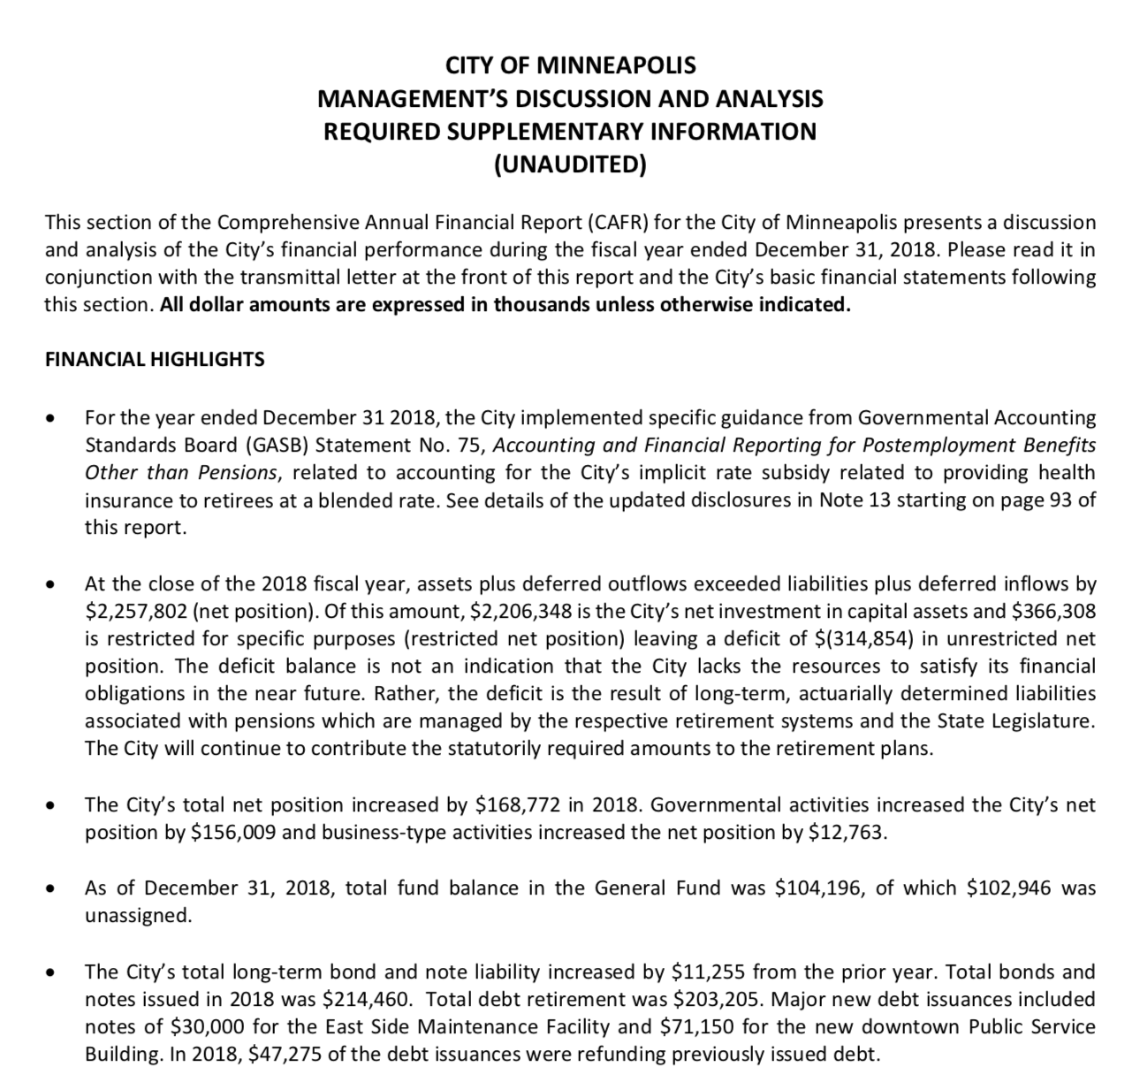
Notes:
PAGE 5-7

Slide 24
2. Basic Financial Statement
Government-Wide Financial Statements
Accrual accounting
Statement of net position
Statement of activities
Primary government
State and local government
Separate elected body
Legally and financially separate from other governments
Component units
Appointed by the primary government
Financial relationship
Notes:
Component unit: airport, hospital

Slide 25
2. Basic Financial Statement
Statement of Net Position
Helps to emphasize the governmental focus on resources available
Net Position
Net investment in capital assets: Adjusted for depreciation
Restricted: By creditors, grantors, donors, law, and regulators
Unrestricted
$Assets+Deferred Outflows of Resources$ =
$$Liabilities+Deferred Inflows of Resources+ Net Position$$
Notes:
Inflows/Outflows: consumption and acquisition of resources that are applicable to a future period.

Slide 26
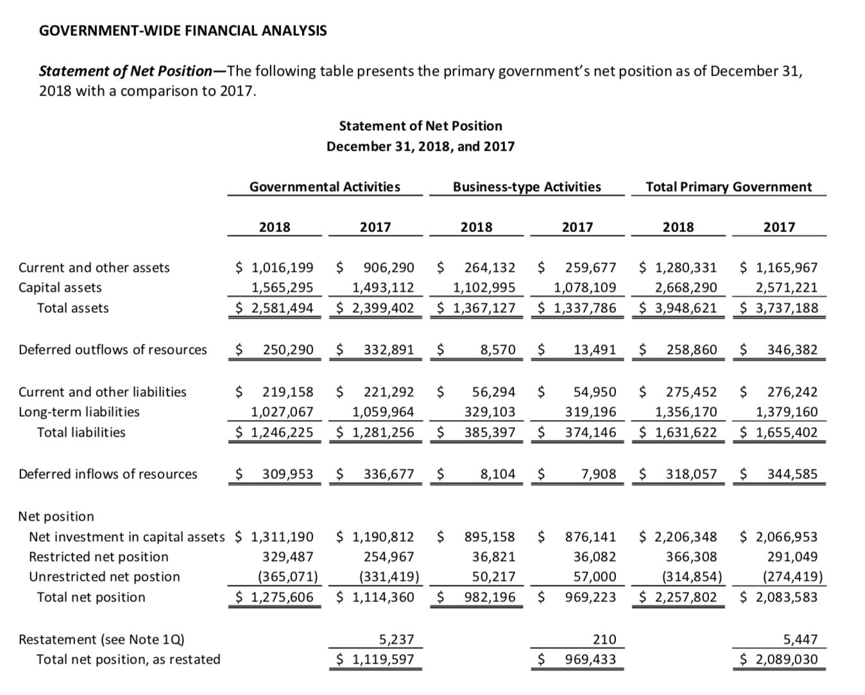
Notes:
To use the modified approach, the government has to stablish a level of condition to maintain infrastructure

Slide 27
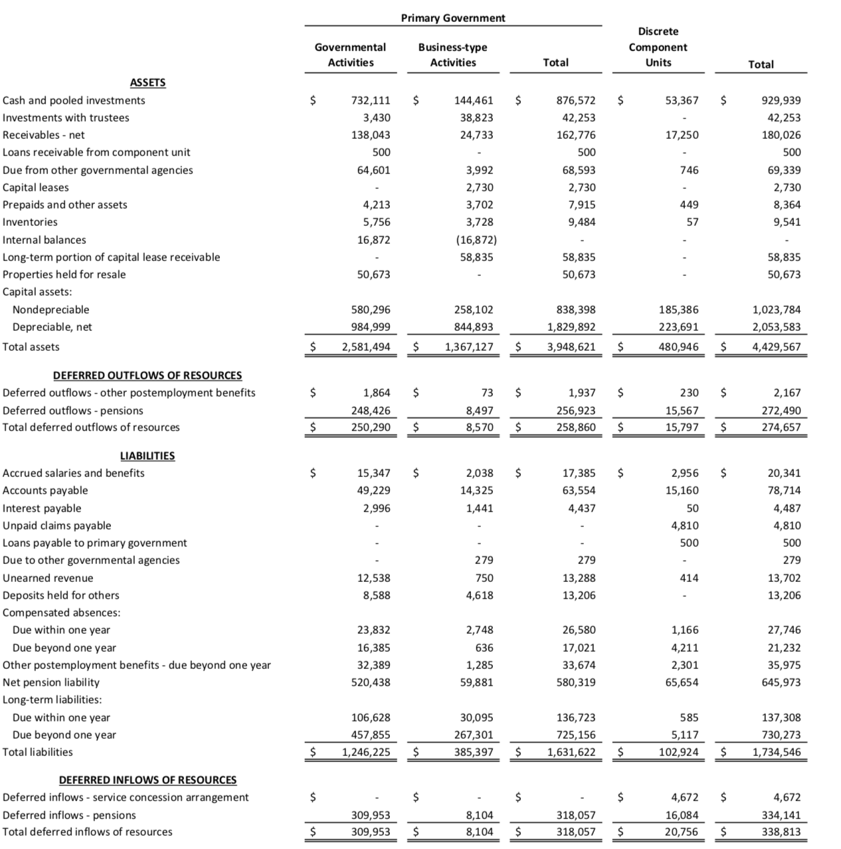
Notes:
Page 31

Slide 28
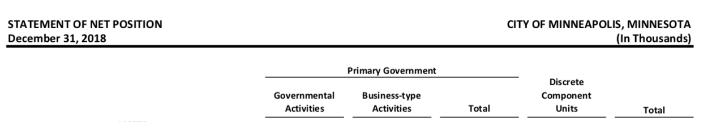
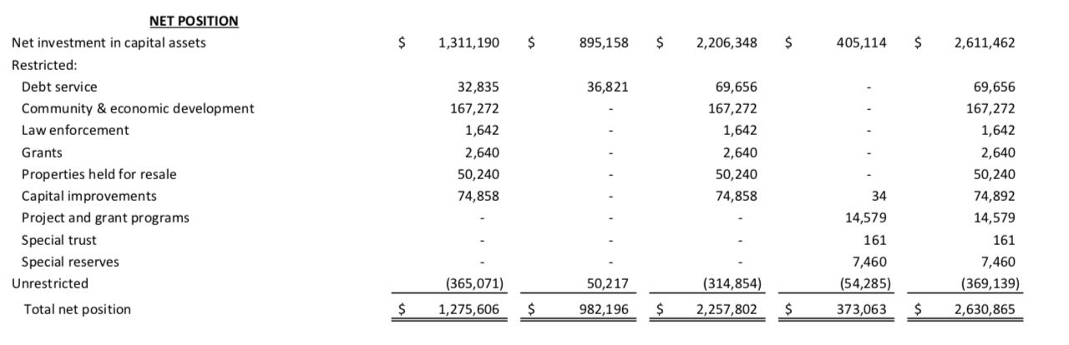

Slide 29
2. Basic Financial Statement
Statement of Activities
Revenues and expenses of the government
Expenses: By function or program
Functions: Primary governments and component units
Primary governments: Governmental activity and business-type activity
Shows details of:
Expenses
Dedicated revenues
= Net Expenses or revenues

Slide 30
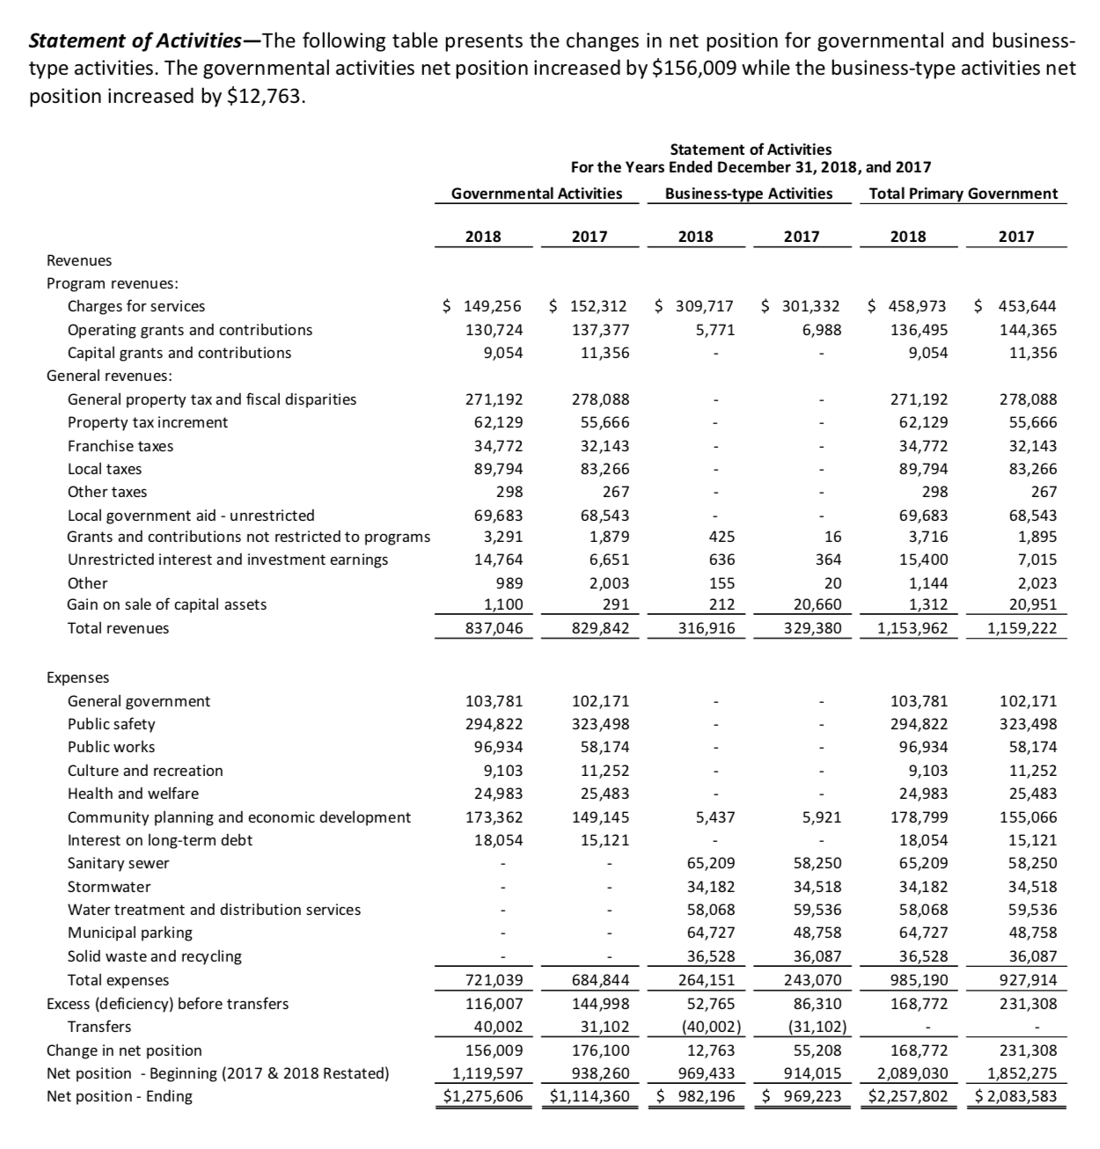
Taxes
User Fees
Intergovernmental grants
Earnings on investments

Slide 31
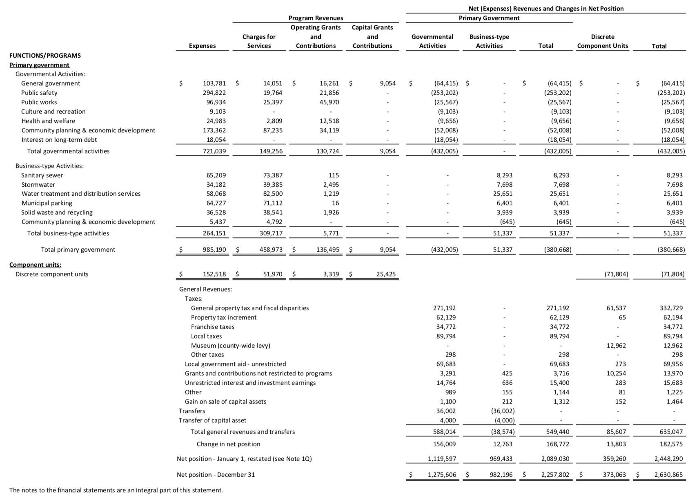
Revenues by Function
Expenses by Function
Net revenues/expenses by program
Line Item
Functions
General Revenues, Unrestricted Contributions, Transfers &
Changes in NA
Changes in Net Position

Slide 32
2. Basic Financial Statement
Fund Financial Statements
Required Statements
Balance Sheet
Statement of Revenues, Expenditures, and Changes in Fund Balances
Statements show:
The general fund
Other major funds
Smaller funds may be aggregated in an other-funds column
Total of all Governmental Funds
Notes:
Component unit: airport, hospital

Slide 33
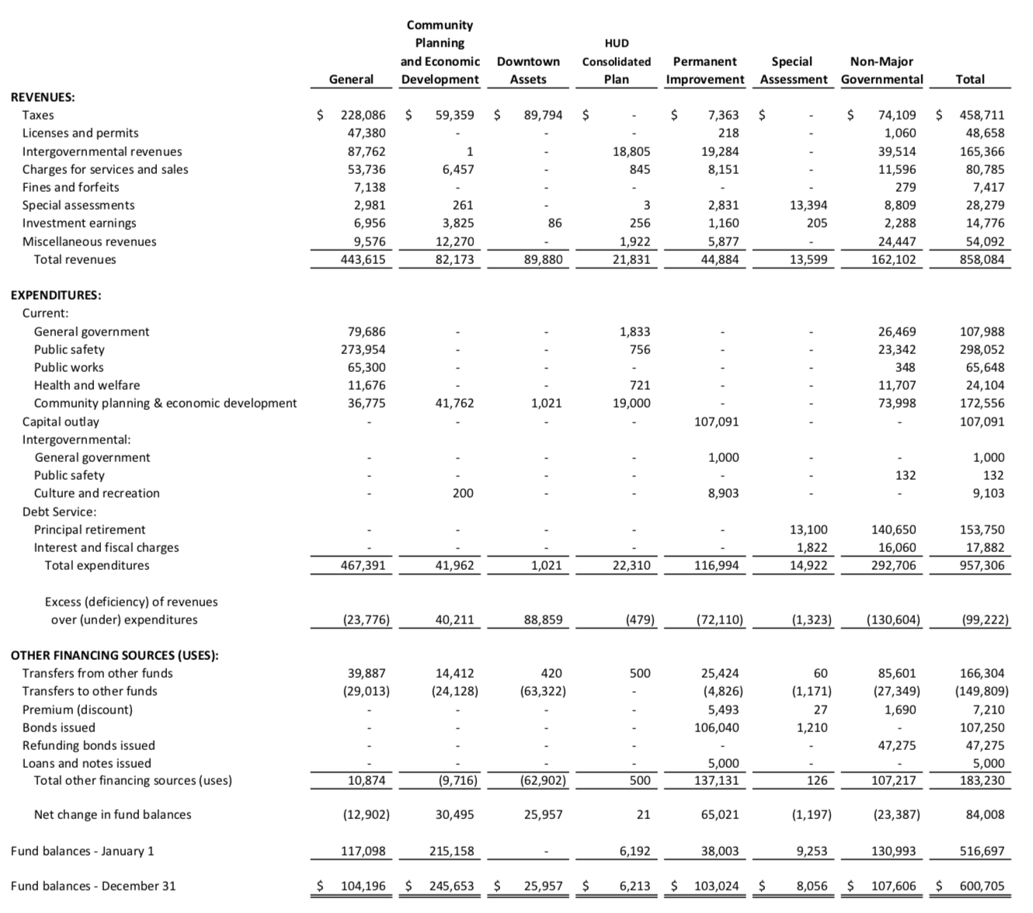
Governmental Fund
Modified Accrual Accounting
Notes:
Governmental Funds

Slide 34
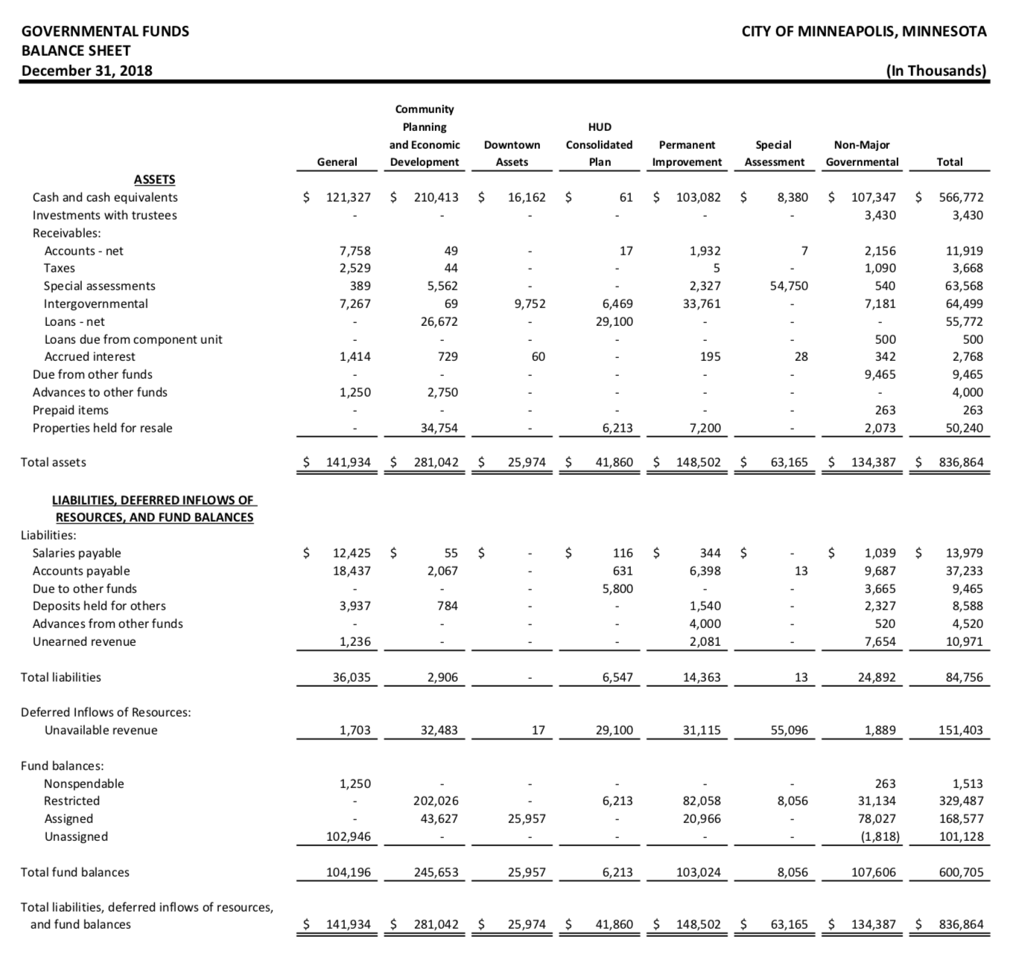
Governmental Fund
Modified Accrual Accounting
No long-term assets/liabilities
Fund Balance
Notes:
Governmental Funds
Restricted: Donors, grantors, creditors, law

Slide 35
2. Basic Financial Statement
Proprietary funds:
Accrual basis of accounting
Statement of net position
Statement of revenues, expenses, and changes in fund net position
Statement of cash flow
Use direct method
Structure - cash flows from:
Operating activities
Non-capital financing activities
Capital and related financing activities
Investing activities
Notes:
Proprietary funds are used to account for activities that are run on a business-like basis.

Slide 36
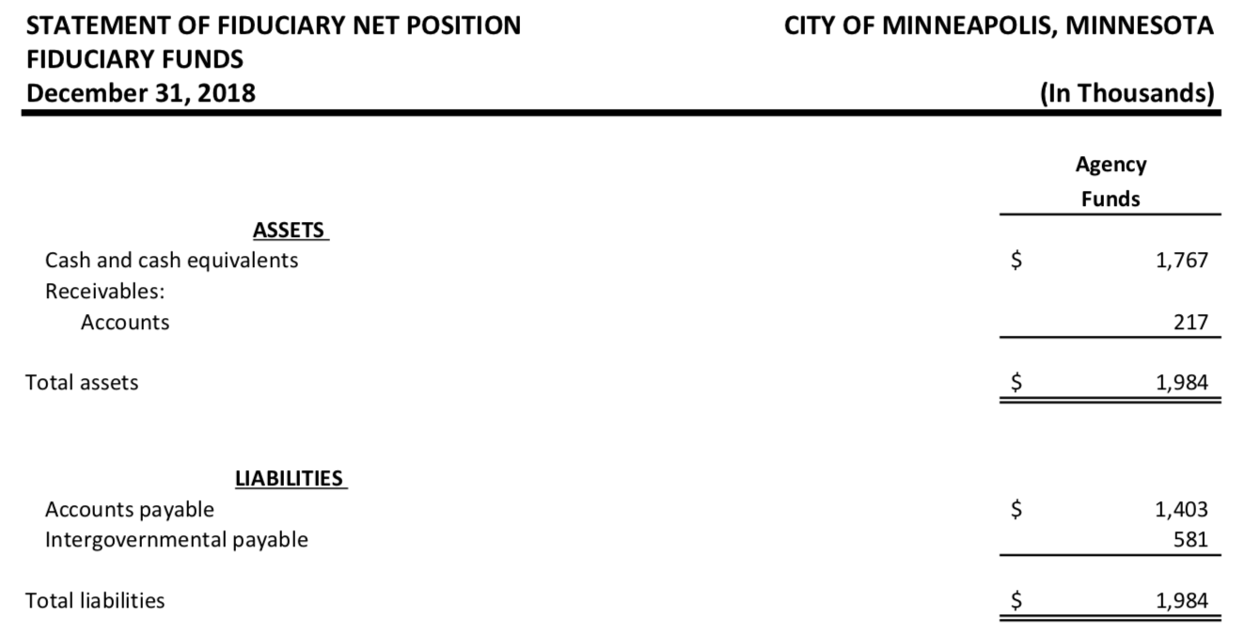
2. Basic Financial Statement
Fiduciary funds:
Held for other governments
→ Not included in the government-wide financial statement
Accrual basis of accounting
Statement of net position
Statement of activities
Assets = Liabilities
Funds are held temporarily

